Slide 1
Big Data And Hadoop
Simranjit Singh

Slide 2


Agenda
What is Big Data?
What is Hadoop?
Hadoop Ecosystem.
Apache Spark.
Case Study.

Slide 3
What is Big Data ?
Extremely large data.
Data comparable to terabytes, petabytes etc.

Slide 4
What is Big Data ?
Complex to analyze without specialized tools.
Scary !!!!

Slide 5
What is Hadoop?
An open source software platform for distributed storage and distributed processing of very large data set on computer clusters built from commodity hardware

Slide 6
Why Hadoop?
Data is too voluminous.
Terabytes of data per day.
Vertical scaling doesn’t help.
Disk seek times.
Hardware failures.
Horizontal scaling is linear.

Slide 7
Hadoop Ecosystem
Core components.
Third party components.

Slide 8
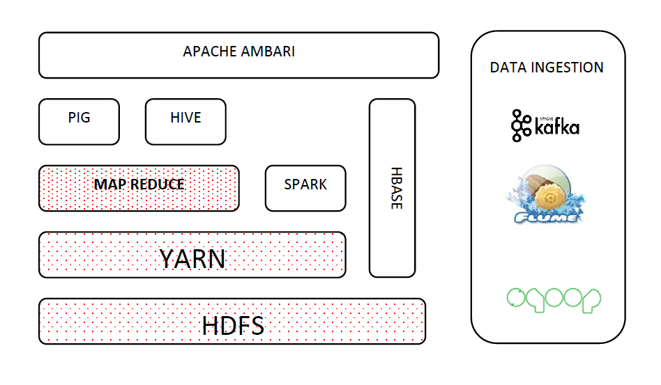
Core Hadoop
Cluster Monitoring
Data Processing
Job scheduling
Data Storage

Slide 9

Apache Spark
Spark engine is for large-scale
data processing.
Speed
Up to 100x faster than
MapReduce.
Everywhere
Runs on Hadoop, standalone
or cloud.

Slide 10
Map Task
Splits input data set in independent chunks.
Processes each in parallel.
Sorts output data.

Slide 11
Reduce Task
Output of map is now input to reduce.
Aggregates the data.

Slide 12
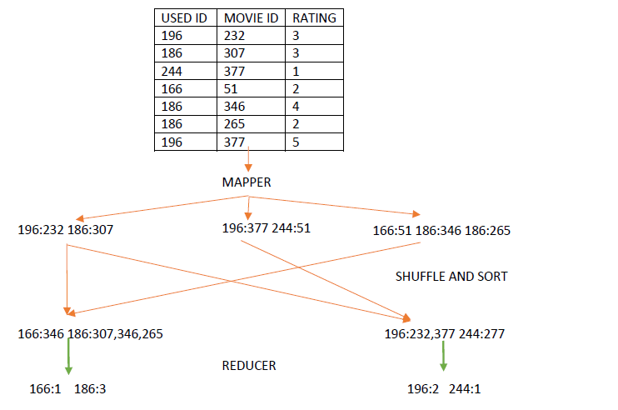
Map/Reduce Example
Get number of movies rated by specific user?

Slide 13
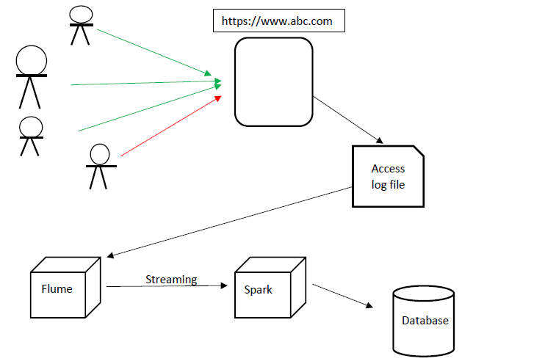
Use Case: Real Time Log Monitoring
Monitor access logs of web application.
Helps to detect security threats.
Analyze network traffic.

Slide 14
Thanks !!!

